Slide 1
Stored Energy and Forces on Solenoids
(derived with the Energy Method)
Outline
Lorentz Force on a Coil
Energy Method for Calculating Force
Examples

Slide 2
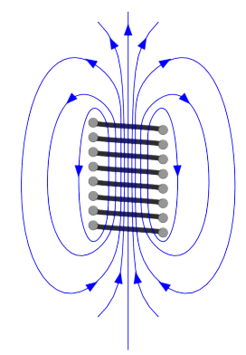
What Sets the Limit ?
Pressure Under Water
1000 m Submarine 1000 psi
4000 m Ocean Floor Submersible 6000 psi
80T Pulsed Magnet 200,000 psi
(1.3GPascals, 130 kg/mm²)
…exceeds the strength of most materials…
…within a factor of three of theoretical ultimate
tensile strength…
Strong
Electromagnets
Generate
HUGE Forces

Slide 3
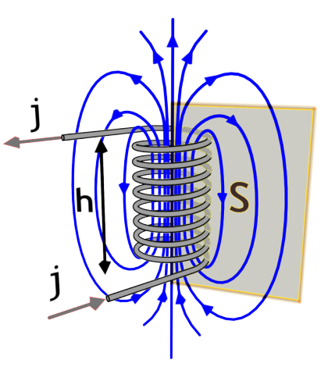




Review of Solenoids
For a sufficiently long solenoid…

Slide 4
Qualitative Analysis of the Force
N
S
force density [N/m³]
…need to know the field inside the wire

Slide 5

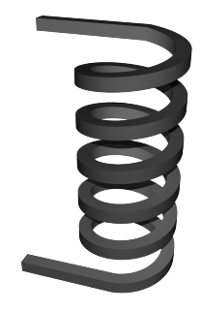








The H-fields Inside the Solenoid Wire
Lets assume that in cross-section each of the wires that forms the solenoid is a little square, with dimension Δ on a side:
Current density inside each wire…
…how does the field vary across wire ?

Slide 6
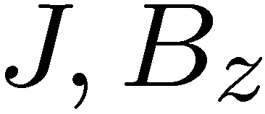

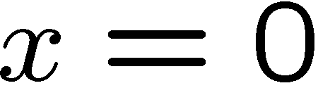

The H-fields Inside the Solenoid Wire
H-field changes linearly from inside to outside of the wire…
“INSIDE”
“OUTSIDE”

Slide 7


Force on the Incremental Section of the Solenoid Wire
The incremental force density acting on the small ‘cube’ of wire is…
The incremental force acting on the small ‘cube’ of wire is…

Slide 8



Force on the Solenoid
For N wires, the total radial force on the solenoid is…
Note:
- Radial force grows as i² – does not depend on direction of current
- Tends to expand the coil
This was a relatively simple problem and it took a while to derive …
IS THERE AN EASIER WAY ?

Slide 9


Energy Method: An Easier Way !
ELECTRICAL
INPUT
MECHANICAL
OUTPUT
“LOSSLESS SYSTEM”
First law for solenoid…
N
-
+
Power flow…
S
How is energy stored in the coil ?

Slide 10



Reminder: Stored Energy in the (Linear) Coil
If L is not a function of time…
…where E is energy stored in the field of the inductor any instant in time

Slide 11



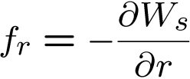
Relating Stored Energy to Force
Lets use chain rule…
This looks familiar…
Comparing similar terms suggests…

Slide 12
Stored Energy and Force
Consider stored energy to depend on flux linkage and radius:
Lets use the chain rule…
q
POWER BEING
STORED
ELECTRICAL
INPUT POWER
MECHANICAL
OUTPUT POWER
VELOCITY
VOLTAGE IN TERMS OF FLUX LINKAGE
FOR SOLENOID
FORCE COMPUTED USING PARTIAL DERIVATIVE
STORED ENERGY FOR SHORTED SOLENOID

Slide 13


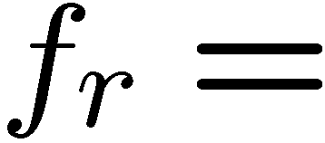
Force on the Solenoid
If we can find the stored energy, we can immediately compute the force…
…lets take all the things we know to put this together…
Exactly what we got from calculating internal fields and taking integrals over multiple dimensions

Slide 14

Force from potential and stored energy
Force from a potential:
Force from stored energy:

Slide 15
Gravitational force:

Slide 16
Magnetic Force

Slide 17


Energy Density of the Magnetic Field
What is the energy density stored in the coil ?
For a long coil the stored energy is…
We can rewrite this as
The magnetic field not only generates a force, but can also be used to
find the stored energy !

Slide 18

Magnetic Poetry
magnetic strontium ferrite, SrFe12O19, particles dispersed in the elastomer Hypalon
Image by Steve Johnson http://www.flickr.com/photos/artbystevejohnson/4621636807/on flickr.
Field lines
Back (brown) side
Front (printed) side
Domains (arrows indicate field direction)

Slide 19





Magnetic Poetry
magnet
fridge
PRESSURE

Slide 20

Magnetic Circuit Example
Variable-Reluctance Motor
Which configuration has the max flux, λ ?
+
-

Slide 21
Example: Differential Transformer
hot wire
neutral wire
secondary
solenoid switch
If the current in the hot wire is the same as the current in the
neutral wire, the induced current in the secondary is zero.

Slide 22
Example: Differential Transformer
hot wire
neutral wire
secondary
solenoid switch
If some current is lost,
current in the secondary opens the solenoid switch.

Slide 23
KEY TAKEAWAYS
Energy method for calculating Forces
calculated at constant flux linkage

Slide 24
MIT OpenCourseWare
http://ocw.mit.edu
6.007 Electromagnetic Energy: From Motors to Lasers
Spring 2011
For information about citing these materials or our Terms of Use, visit: http://ocw.mit.edu/terms.

